Slide 1
PIPELINING AND VECTOR PROCESSING
Parallel Processing
Pipelining
Arithmetic Pipeline
Instruction Pipeline
RISC Pipeline
Vector Processing
Array Processors

Slide 2
PARALLEL PROCESSING
Parallel Processing
Parallel processing is a term used for a large class of techniques that
are used to provide simultaneous data-processing tasks for the
purpose of increasing the computational speed of a computer system.

Slide 3
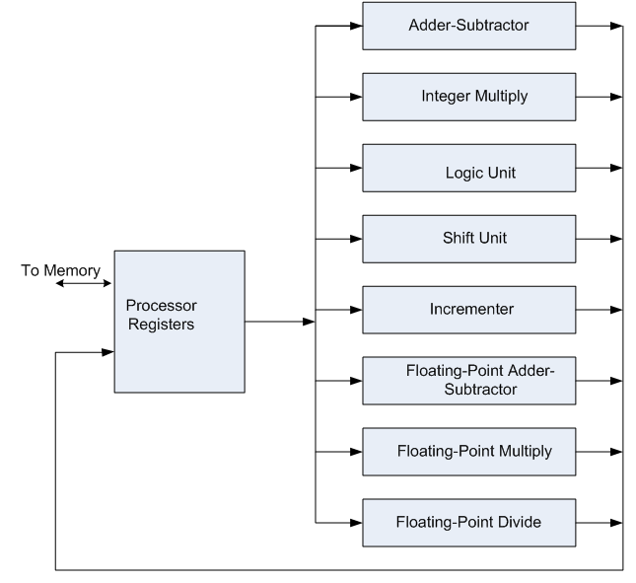
PARALLEL PROCESSING
Example of parallel Processing:
  Multiple Functional Unit:
  Separate the execution unit into
  eight functional units operating in
  parallel.

Slide 4
PARALLEL COMPUTERS
Parallel Processing
Architectural Classification
  Flynn's classification
    Based on the multiplicity of Instruction Streams and Data Streams
    Instruction Stream
      Sequence of Instructions read from memory
    Data Stream
      Operations performed on the data in the processor
Number of Data Streams
Single
Multiple
Number of
Instruction
Streams
Single
SISD
SIMD
Multiple
MISD
MIMD

Slide 5
SISD COMPUTER SYSTEMS
Parallel Processing
Control
Unit
Processor
Unit
Data stream
Memory
Instruction stream
Characteristics:
  One control unit, one processor unit, and one memory unit
  Parallel processing may be achieved by means of:
    multiple functional units
    pipeline processing

Slide 6
MISD COMPUTER SYSTEMS
Parallel Processing
M
CU
P
M
CU
P
Memory
•
•
•
•
•
•
M
CU
P
Data stream
Instruction stream
Characteristics
- There is no computer at present that can be classified as MISD

Slide 7
SIMD COMPUTER SYSTEMS
Parallel Processing
Memory
Data bus
Control Unit
Instruction stream
P
P
• • •
P
Processor units
Data stream
Alignment network
M
M
• • •
M
Memory modules
Characteristics
  Only one copy of the program exists
  A single controller executes one instruction at a time

Slide 8
MIMD COMPUTER SYSTEMS
Parallel Processing
P
M
P
M
• • •
P
M
Interconnection Network
Shared Memory
Characteristics:
  Multiple processing units (multiprocessor system)
  Execution of multiple instructions on multiple data
Types of MIMD computer systems
- Shared memory multiprocessors
- Message-passing multicomputers (multicomputer system)
The main difference between multicomputer system and multiprocessor system is that the multiprocessor system is controlled by one operating system that provides interaction between processors and all the component of the system cooperate in the solution of a problem.

Slide 9
PIPELINING
Pipelining
  A technique of decomposing a sequential process into suboperations, with each subprocess being executed in a special dedicated segment that operates concurrently with all other segments.
A_{i} * B_{i} + C_{i} for i = 1, 2, 3, ... , 7
A_{i}
B_{i}
Memory
C_{i}
Segment 1
R1
R2
Multiplier
Segment 2
R3
R4
Segment 3
Adder
R5
Suboperations in each segment: R1 ← A_{i}, R2 ← B_{i} Load A_{i} and B_{i}
R3 ← R1 * R2, R4 ← C_{i} Multiply and load C_{i}
R5 ← R3 + R4 Add

Slide 10
OPERATIONS IN EACH PIPELINE STAGE
Pipelining
Clock
Pulse
Segment 1
Segment 2
Segment 3
  Number R1 R2 R3 R4 R5
  1 A1 B1 --- --- -------
  2 A2 B2 A1 * B1 C1 -------
  3 A3 B3 A2 * B2 C2 A1 * B1 + C1
  4 A4 B4 A3 * B3 C3 A2 * B2 + C2
  5 A5 B5 A4 * B4 C4 A3 * B3 + C3
  6 A6 B6 A5 * B5 C5 A4 * B4 + C4
  7 A7 B7 A6 * B6 C6 A5 * B5 + C5
  8 A7 * B7 C7 A6 * B6 + C6
  9 A7 * B7 + C7

Slide 11
GENERAL PIPELINE
Pipelining
General Structure of a 4-Segment Pipeline
Clock
Input
S
R
S
R
S
R
S
R
1
1
2
2
3
3
4
4
Space-Time Diagram
  The following diagram shows 6 tasks T1 through T6 executed in 4 segments.
Clock cycles
1
2
3
4
5
6
7
8
9
T3
T4
No matter how many segments, once the pipeline is full, it takes only one clock period to obtain an output.
1
T1
T2
T5
T6
Segment
2
T1
T2
T3
T4
T5
T6
3
T1
T2
T3
T4
T5
T6
4
T1
T2
T3
T4
T5
T6

Slide 12
PIPELINE SPEEDUP
Pipelining
  Consider the case where a k-segment pipeline used to execute n tasks.
  n = 6 in previous example
  k = 4 in previous example
Pipelined Machine (k stages, n tasks)
  The first task t1 requires k clock cycles to complete its operation since there are k segments
  The remaining n-1 tasks require n-1 clock cycles
  The n tasks clock cycles = k+(n-1) (9 in previous example)
Conventional Machine (Non-Pipelined)
  Cycles to complete each task in nonpipeline = k
  For n tasks, n cycles required is
Speedup (S)
  S = Nonpipeline time /Pipeline time
For n tasks: S = nk/(k+n-1)
As n becomes much larger than k-1; Therefore, S = nk/n = k

Slide 13
PIPELINE AND MULTIPLE FUNCTION UNITS
Pipelining
Example:
- 4-stage pipeline
- 100 tasks to be executed
- 1 task in non-pipelined system; 4 clock cycles
Pipelined System : k + n - 1 = 4 + 99 = 103 clock cycles
Non-Pipelined System : n*k = 100 * 4 = 400 clock cycles
Speedup : S_{k} = 400 / 103 = 3.88

Slide 14
Types of Pipelining
Arithmetic Pipeline
Instruction Pipeline

Slide 15
ARITHMETIC PIPELINE
Arithmetic Pipeline
Floating-point adder
Exponents
Mantissas
a
b
A
B
[1] Compare the exponents
[2] Align the mantissa
[3] Add/sub the mantissa
[4] Normalize the result
R
R
Compare
Difference
Segment 1:
exponents
by subtraction
        X = A x 10ª = 0.9504 x 10³
        Y = B x 10^{b} = 0.8200 x 10²
      1) Compare exponents :
      3 - 2 = 1
      2) Align mantissas
        X = 0.9504 x 10³
        Y = 0.08200 x 10³
      3) Add mantissas
        Z = 1.0324 x 10³
      4) Normalize result
        Z = 0.10324 x 10⁴
R
Segment 2:
Choose exponent
Align mantissa
R
Segment 3:
Add or subtract
mantissas
R
R
Segment 4:
Adjust
Normalize
exponent
result
R
R

Slide 16
INSTRUCTION CYCLE
Instruction Pipeline
Pipeline processing can occur also in the instruction stream. An instruction
pipeline reads consecutive instructions from memory while previous
instructions are being executed in other segments.
Six Phases* in an Instruction Cycle
[1] Fetch an instruction from memory
[2] Decode the instruction
[3] Calculate the effective address of the operand
[4] Fetch the operands from memory
[5] Execute the operation
[6] Store the result in the proper place
* Some instructions skip some phases
* Effective address calculation can be done in the part of the decoding phase
* Storage of the operation result into a register is done automatically in the execution phase
==> 4-Stage Pipeline
[1] FI: Fetch an instruction from memory
[2] DA: Decode the instruction and calculate the effective address of the operand
[3] FO: Fetch the operand
[4] EX: Execute the operation

Slide 17
INSTRUCTION PIPELINE
Instruction Pipeline
Execution of Three Instructions in a 4-Stage Pipeline
Conventional
i
FI
DA
FO
EX
i+1
FI
DA
FO
EX
i+2
FI
DA
FO
EX
Pipelined
i
FI
DA
FO
EX
i+1
FI
DA
FO
EX
i+2
FI
DA
FO
EX

Slide 18
INSTRUCTION EXECUTION IN A 4-STAGE PIPELINE
Instruction Pipeline
Segment1:
Fetch instruction
from memory
Decode instruction
Segment2:
and calculate
effective address
yes
Branch?
no
Segment3:
Fetch operand
from memory
Segment4:
Execute instruction
Interrupt
yes
Interrupt?
handling
no
Step:
1
2
3
4
5
6
7
8
9
10
11
12
13
Update PC
1
FI
DA
FO
EX
Instruction
Empty pipe
2
FI
DA
FO
EX
(Branch)
3
FI
DA
FO
EX
4
FI
FI
DA
FO
EX
5
FI
DA
FO
EX
6
FI
DA
FO
EX
7
FI
DA
FO
EX

Slide 19
Pipeline Conflicts
  Pipeline Conflicts : 3 major difficulties
  1) Resource conflicts: memory access by two segments at the same time. Most of these conflicts can be resolved by using separate instruction and data memories.
    2) Data dependency: when an instruction depend on the result of a previous instruction, but this result is not yet available.
    Example: an instruction with register indirect mode cannot proceed to fetch the operand if the previous instruction is loading the address into the register.
    3) Branch difficulties: branch and other instruction (interrupt, ret, ..) that change the value of PC.

Slide 20
RISC Computer
RISC Pipeline
RISC (Reduced Instruction Set Computer)
- Machine with a very fast clock cycle that executes at the rate of one instruction per cycle.
Major Characteristic
  Relatively few instructions
  Relatively few addressing modes
  Memory access limited to load and store instructions
  All operations done within the registers of the CPU
  Fixed-length, easily decoded instruction format
  Single-cycle instruction execution
  Hardwired rather than microprogrammed control
  Relatively large number of registers in the processor unit
  Efficient instruction pipeline
  Compiler support for efficient translation of high-level language programs into machine language programs

Slide 21
RISC PIPELINE
RISC Pipeline
Instruction Cycle of Three-Stage Instruction Pipeline
I: Instruction Fetch
A: Decode, Read Registers, ALU Operation
E: Transfer the output of ALU to a register, memory, or PC.
Types of instructions
Data Manipulation Instructions
Load and Store Instructions
Program Control Instructions

Slide 22
VECTOR PROCESSING
Vector Processing
There is a class of computational problems that are beyond the capabilities of a conventional computer. These problems require a vast number of computations that will take a conventional computer days or even weeks to complete.
Vector Processing Applications
Problems that can be efficiently formulated in terms of vectors and matrices
  Long-range weather forecasting - Petroleum explorations
  Seismic data analysis - Medical diagnosis
  Aerodynamics and space flight simulations
  Artificial intelligence and expert systems
  Mapping the human genome
  Image processing
Vector Processor (computer)
Ability to process vectors, and matrices much faster than conventional computers

Slide 23
VECTOR PROGRAMMING
Vector Processing
Fortran Language
DO 20 I = 1, 100
20 C(I) = B(I) + A(I)
Conventional computer (Mahine language)
Initialize I = 0
20 Read A(I)
Read B(I)
Store C(I) = A(I) + B(I)
Increment I = I + 1
If I ≤ 100 goto 20
Vector computer
C(1:100) = A(1:100) + B(1:100)

Slide 24
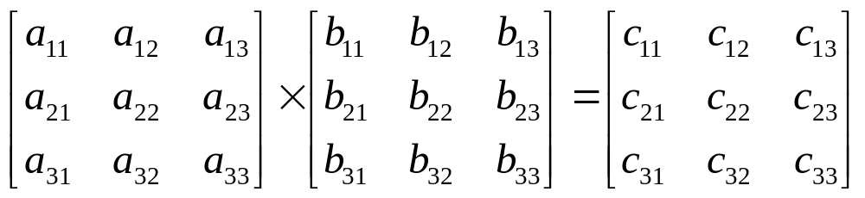
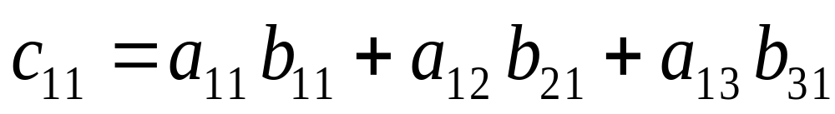
VECTOR PROGRAMMING
  Vector Instruction Format :
  ADD A B C 100
  Matrix Multiplication
    3 x 3 matrices multiplication :

Slide 25

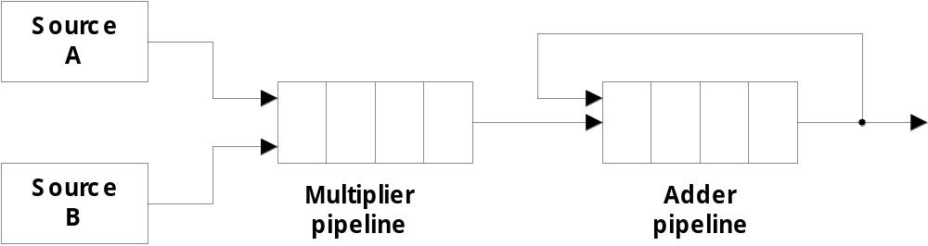
  Pipeline for calculating an inner product :
    Floating point multiplier pipeline : 4 segments
    Floating point adder pipeline : 4 segments
      after 1st clock input
A₁B₁
0
0
0
0
0
0
0
      after 4th clock input
A₄B₄ A₃B₃ A₂B₂ A₁B₁
0
0
0
0

Slide 26

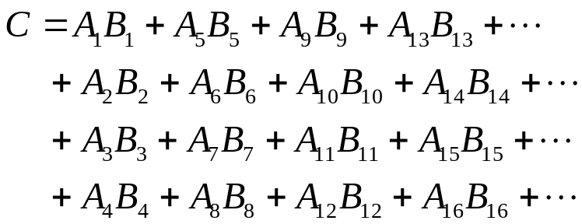
      after 8th clock input
A₈B₈ A₇B₇ A₆B₆ A₅B₅ A₄B₄ A₃B₃ A₂B₂ A₁B₁
      after 9th, 10th, 11th ,...
A₁B₁
₊
A₅B₅
A₉B₉ A₈B₈ A₇B₇ A₆B₆ A₄B₄ A₃B₃ A₂B₂

Slide 27
MEMORY INTERLEAVING
Vector Processing
Pipeline and vector processors often require simultaneous access to memory from tow or more sources.
An instruction pipeline may require the fetching of an instruction and an operand at the same time from two different segments.
An arithmetic pipeline usually requires two or more operands to enter the pipeline at the same time.
Instead of using two memory buses for simultaneous access, the memory can be partitioned into a number of modules connected to common memory address and data buses.
Address Interleaving
Different sets of addresses are assigned to different memory modules
For example, in a two-module memory system, the even addresses may be in one module and the odd addresses in the other.

Slide 28
MEMORY INTERLEAVING
Vector Processing
Address bus
M0 M1 M2 M3
AR
AR
AR
AR
Memory
Memory
Memory
Memory
array
array
array
array
DR
DR
DR
DR
Data bus
A vector processor that uses an n-way interleaved memory can fetch n operands from n different modules. By staggering the memory access, the effective memory cycle time can be reduced by a factor close to the number of modules.
A CPU with instruction pipeline can take advantage of multiple memory modules so that each segment in the pipeline can access memory independent of memory access from other segments.

Slide 29
  Supercomputer
    Supercomputer = Vector Instruction + Pipelined floating-point arithmetic
    High computational speed, fast and large memory system.
    Extensive use of parallel processing.
    It is equipped with multiple functional units and each unit has its own pipeline configuration.
    Optimized for the type of numerical calculations involving vectors and matrices of floating-point numbers.
    Limited in their use to a number of scientific applications:
      numerical weather forecasting,
      seismic wave analysis,
      space research.
    They have limited use and limited market because of their high price.

Slide 30
  Supercomputer
    Performance Evaluation Index
      MIPS : Million Instruction Per Second
      FLOPS : Floating-point Operation Per Second
        megaflops : 10⁶, gigaflops : 10⁹
    Cray supercomputer :
      Cray-1 : 80 megaflops, (1976)
      Cray-2 : 12 times more powerful than the Cray-1
    VP supercomputer : Fujitsu
      VP-200 : 300 megaflops, 83 vector instruction, 195 scalar instruction
      VP-2600 : 5 gigaflops

Slide 31
9-7 Array Processors
  Performs computations on large arrays of data
    Attached array processor :
      Auxiliary processor attached to a general purpose computer to improve the numerical computation performance.
    SIMD array processor :
      Computer with multiple processing units operating in parallel
        Vector C = A + B c_{i} = a_{i} + b_{i}
  Although both types manipulate vectors, their internal organization is different.

Slide 32
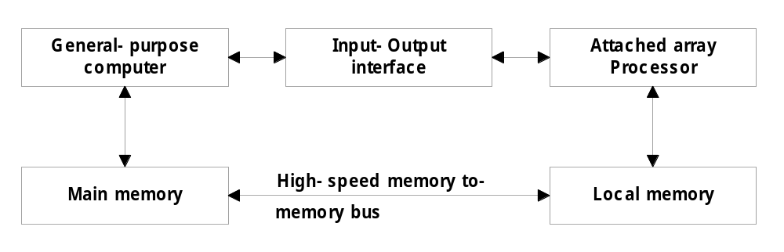
9-7 Array Processors
Attached array processor
Designed as a peripheral for complex scientific applications attached with a conventional host computer.
The peripheral is treated like and external interface. The data are transferred from main memory to local memory through high-speed bus.
The general-purpose computer without the attached processor serves the users that need conventional data processing.

Slide 33
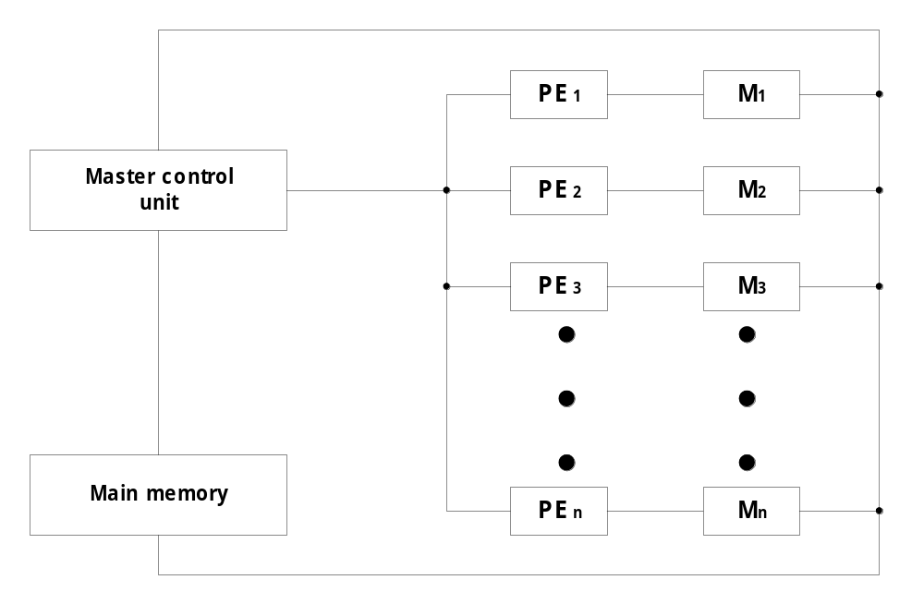
9-7 Array Processors
SIMD array processor
Scalar and program control instructions are directly executed within the master control unit.
Vector instructions are broadcast to all PEs simultaneously
Example: C = A + B
  The master control unit first stores the i ^{th} components a_{i} and b_{i} in local
  memory M_{i} for i = 1, 2, …, n.
  Broadcasts the floating-point add instruction c_{i} = a_{i} + b_{i} to all PEs
  The components of c_{i} are stored in fixed locations in each local
  memory.

